Slide 1


Slide 2

PRESENTATION
EM NORMANDIE
BUSINESS SCHOOL

Slide 3


150 YEARS OF HISTORY
An established school and holder of the most prestigious international accreditations (AACSB, EQUIS), EM Normandie offers an innovative experience based on 4 pillars to support its students in all stages of their professional and personal development:
Innovative pedagogy
International exposure
Strong connection with the business world
Rich student society life
Video: https://youtu.be/8v2iyZk8VSU

Slide 4






CERTIFIED
EXCELLENCE
INTERNATIONAL
ACCREDITATIONS
EQUIS and AACSB 1% of Business Schools in the world are doubly accredited
86th among the best European Business Schools and 73rd place among the best Masters in Management of the Financial Times
78th out of 130 in the annual ranking of the best Masters in in Management by QS World University Rankings
Conference of Grandes Ecoles among 38 Grandes Ecoles de Management awarding the Master Degree among more than 200 business and management schools in France
BSIS et EFMD (European Foundation for Management Development) label
CEFDG: Secondary school + 5 visa and Master Degree for the Grande Ecole Program issued by the CEFDG Commission d'Evaluation des Formations et Diplômes de Gestion
Secondary school + 3 visa for the Bachelor in International Management
EESPIG: Private Higher Education Institution of General Interest awarded by MESRI
UGEI: Union of Independent Grandes Ecoles
Happy at School

Slide 5



EM NORMANDIE
KEY NUMBERS
1000
INTERNATIONAL STUDENTS
+21 500
ALUMNI
+200
PARTNER UNIVERSITIES
+400
STAFF MEMBERS
175
INTERNATIONAL VISITING PROFESSORS
5 800
STUDENTS

Slide 6

LABEL « BIENVENUE EN FRANCE »
EM Normandie amongst only 11 French Schools of Management to receive the label
The School is ranked among the 74 Higher Education Institutions in France (comprising only 11 Business Schools), to receive this distinction that guarantees international students a high standard of quality in the welcome schemes and initiatives in those institutions certified.
Initiated under the framework of the Welcome to France Plan announced by the French Prime Minister in November 2018, this new label awarded to EM Normandie certifies both the quality of the information given to international students seeking a training programme and the welcome they receive on the various campuses. The School met all the criteria reviewed by the commission: quality and availability of the information, welcome schemes, training programmes offered, housing, life on campus and a high standard of support after graduation.
EM Normandie is rewarded for its offer of training programmes both for its Bachelor International Management, Master in Management, and MS and MScs as well as its customised short programmes. An additional asset also pointed out was the efficiency of its support thanks to the International Affairs department and its single gateway for all welcome steps – the 'Hub’, which directs students in all their administration formalities (resident’s permit, social security and student mutual societies registration, housing, etc.). As for the Corporate and Careers department, it ensures that such publics are given all the necessary keys required to have a clear view of the working world in France whereas the EM Normandie Alumni Association makes a point of involving them fully into the EM Community.
As for student life, the events organised throughout the year on the campuses with the support of Student Societies and Associations contribute to the good integration of international students and to spread an international culture at the School.

Slide 7
STUDY OPPORTUNITIES
Course offer 2021-2022

Slide 8






UNDERGRADUATE PROGRAMMES
FRANCE
Le Havre
Caen
Paris
Management option– 2nd year
Management potion– 3rd year
Bachelor in Management – 3rd year
Bachelor in Management, Logistics and International Commerce – 3rd year
Master in Management – 3rd year
Management Option – 3rd year
Management – 3rd year

Slide 9
UNDERGRADUATE PROGRAMMES
UK & IRELAND
Oxford
Dublin
Management option – 2nd year
Management option – 3rd year
Management option– 2nd year
Management option – 3rd year

Slide 10
GRADUATE PROGRAMMES
FRANCE
Le Havre
Master in Management – 4th year
International Management (Global Track)
Master in Management – 5th year
International Business
International Logistics and Port Management
Supply Chain Management
Paris
Caen
Master in Management – 4th year
Strategy and Consulting – Paris
Master in Management – 5th year
International Events Management* Digital Marketing in Luxury and Lifestyle*
Strategy and Consulting
Master in Management – 5th year
International Marketing and Business Development
Financial Data Management
Master in Management – 4th year
Marketing, Finance or Entrepreneurship/Innovation
Master in Management – 5th year
Information Systems Manager
Digital Entrepreneurship
Master in Management – 4th year
Marketing, Finance or Logistics
Master in Management – 5th year
Audit and Finance
Supply Chain, Logistics and Innovations
Marketing Strategy and Commercial Development
Master in Management – 5th year
Digital Strategy and Innovation
Human Resource management
*Available only during the fall or full-year

Slide 11
GRADUATE PROGRAMMES
UK & IRELAND
Oxford
Dublin
Master in Management – 4th year
International Management (Global Track)
Master in Management – 5th year
Banking, Finance and FinTech
Master in Management – 4th year
International Management (Global Track)
Master in Management – 5th year
Digital Sales
Strategy and Consulting

Slide 12
SHORT TERM PROGRAMMES
Summer School 2022
Tailor-made short term programmes
1-14 July in Le Havre, 15-28 July in Paris
1 to 2 courses, 6 to 12 ECTS credits
For undergraduate and graduate students
Gain insight in Business / Management
Benefit of corporate meetings and visits
Enjoy cultural activities and social events
Develop your competencies, knowledge & skills, cross-cultural sensitivity and network
Video and testimonials: https://youtu.be/BYQ5aBeg-IQ
For undergraduate, graduate, Executive MBA students…
From 1-day customised seminars to 6-week seasonal schools
Combine academic input, corporate meetings as well as cultural activities
Services according to partners’ needs
Contact: Adam Aharram, International Project Manager
short-term@em-normandie.fr

Slide 13

ONE SCHOOL SIX CAMPUSES

Slide 14

CAEN (NORMANDY, FRANCE)
Our campus
3 reasons to study in Caen
Digital Entrepreneurship
International Marketing
Start up incubator « La Koloc »
Notes:
HLT

Slide 15


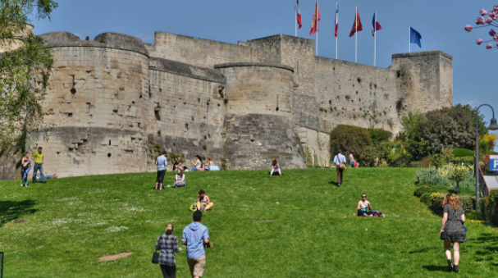
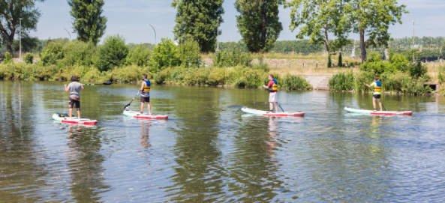

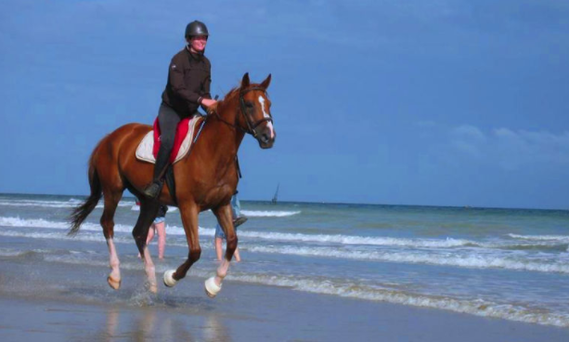
CAEN (NORMANDY, FRANCE)
5 best things to experience
Go the farmers’ market on Sunday morning
Have a stroll in the Castle and pic-nic on the grass
Enjoy the River Orne
Visit the Caen Memorial
Go to the seaside
Notes:
Présentation par Dorota: caen : la ville; vie étudiante bien-être étudiant, historique, carnaval
AFR : ferry, balades en bord de mer, mémorial
Histoire de la ville
Fonded by William the Conqueror, important site of the WWI and near the Dday beaches, specialities of cider and biscuits, student city more than 30000 students, 4 campuses, « ville au cent clochers »,
Fun fact : l’histoire des tombes de William et Mathilde? La légende de la rue froide ?
Go the farmers’ market on Sunday morning at the port
Drink an «embuscade », special local drink with white wine, calvados, beer, lime and red fruit syrup
Go to the seaside by bike or bus and enjoy the beach for a day
Visit the Caen Memorial on WWII
Have a stroll in the Castle and pic-nic on the grass

Slide 16

LE HAVRE (NORMANDY, FRANCE)
Our campus
3 reasons to study in Le Havre
Supply chain management & logistics
International Business
Brand new campus in a student city
Notes:
HLT

Slide 17
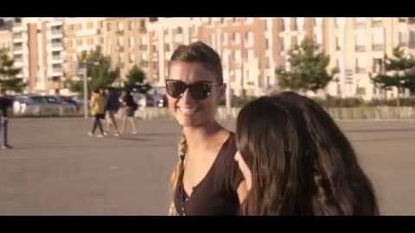
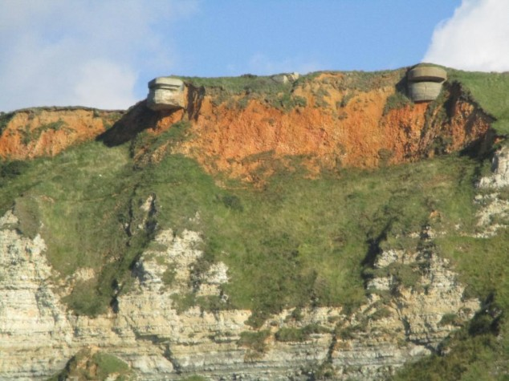
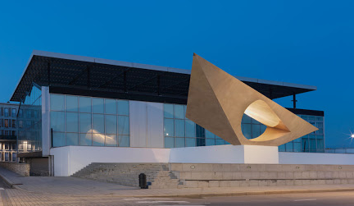
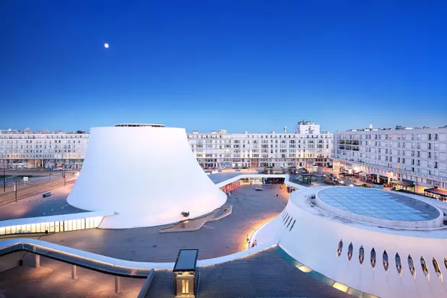
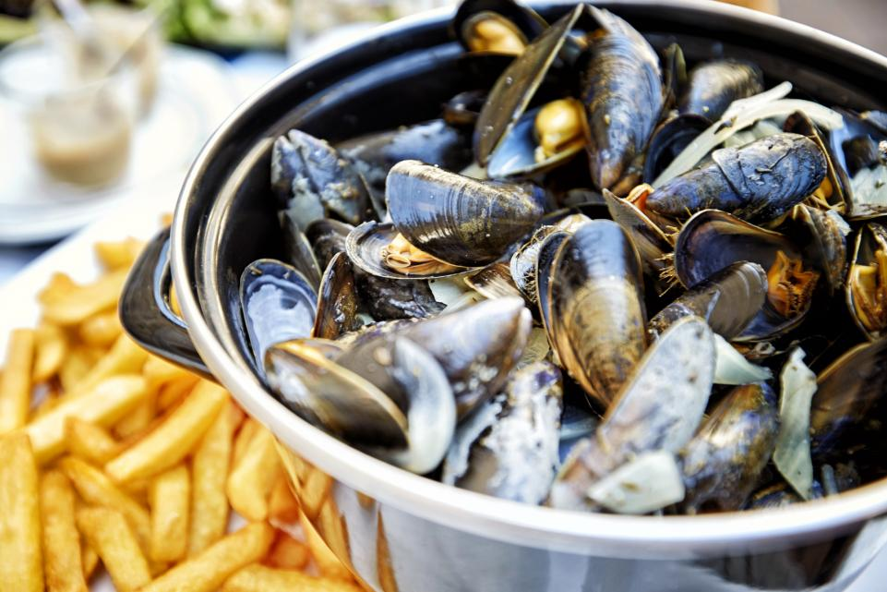

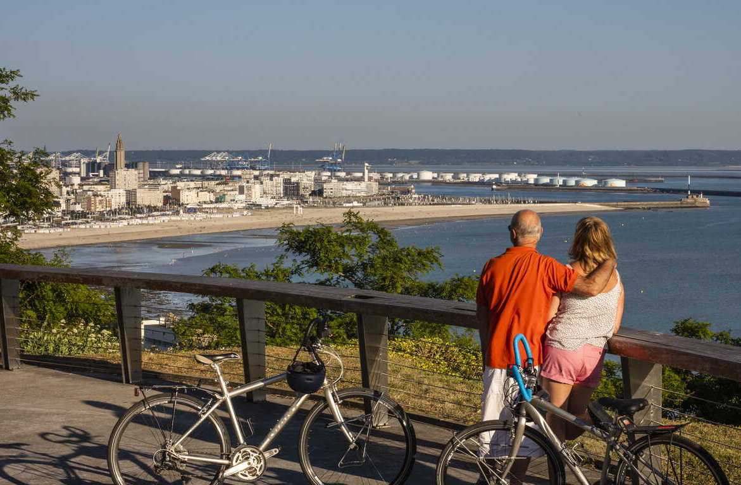
LE HAVRE (NORMANDY, FRANCE)
5 best things to experience
Visit the « Bout du Monde »
Discover the Malraux Museum
Enjoy mussels and french fries on the seaside
See a play or concert
in the Vulcano
Cycle through the city
Notes:
Présentation par Heloise
Histoire de la ville
Unesco city, bombed during WWII and entirely reconstructed by Perret, NYC type of neighborhoods grid of streets, 2 hours from Paris by train, 2nd port of France after Marseille, Claude Monet’s hometown, Edouard Philippe mayor after being prime minister
Fun fact :
Architecture Perret : pas plus de 3 étages car Perret disait que les êtres humains ont besoin de rester proche du sol pour ne pas devenir fous (être terre à terre)
Go to the « bout du monde » up on the cliff where there’s a bunker from WWII
Visit the Musée Malraux called the MUMA (fun poke at the MOMA in NYC) impressionnist Claude Monet etc
Enjoy mussels and french fries on the seaside
Cycle through the city, you can actually go to Paris by bike « la voie verte »
See a show in the Volcan or pot de yaourt : expliquer l’histoire !

Slide 18

PARIS (FRANCE)
Our campus
3 reasons to study in Paris
International Events Management
Digital marketing in luxury and lifestyle
Academic conferences
Notes:
HLT

Slide 19
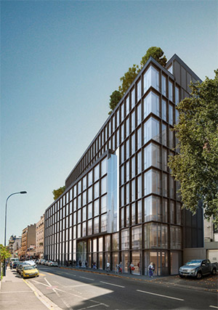
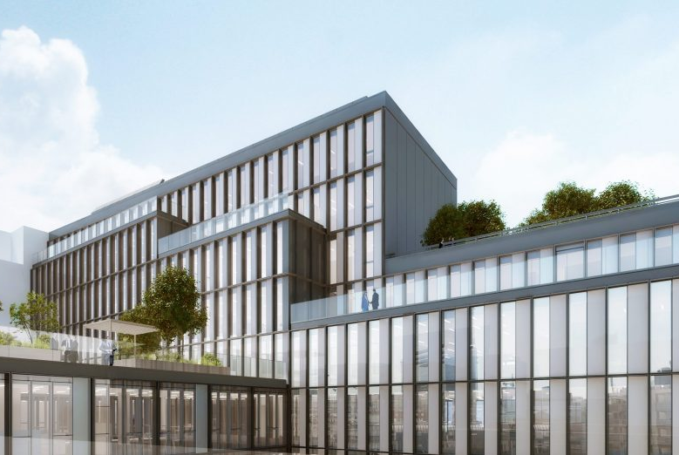
A NEW CAMPUS IN JANUARY 2022!
A spectacular building designed as a new generation educational site!
Notes:
Commentaire :
Audacieuse et visionnaire : Tournée dès ses débuts vers l’international, l’apprentissage par l’action, le monde de l’entreprise (on parlait de « leçons de choses à l’époque » ;-)), la vie associative. 1re École à avoir investi les pédagogies digitales il y a plus de 10 ans !
Fondée sur l’excellence : inscrite dans une démarche d’innovation pédagogique permanente, l’une des seules écoles dotée d’un département EdTech pour assurer la transformation digitale des enseignements et de toute l’expérience apprenante.
Dotée d’un fort rayonnement national et international : un périmètre étendu au fil des années : 5 campus (Caen, Le Havre, Paris, Dublin, Oxford) + 5 000 étudiants + 200 universités et 5 000 entreprises partenaires dans le monde
Centrée sur ses étudiants : La politique de la porte ouverte et la volonté de vous rendre acteur de votre montée en compétences inscrites dans son ADN. Une formation tout au long de la vie.

Slide 20
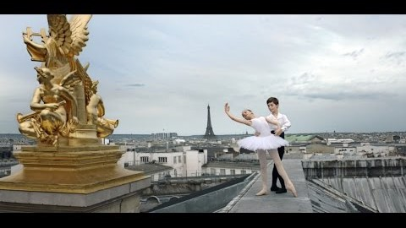

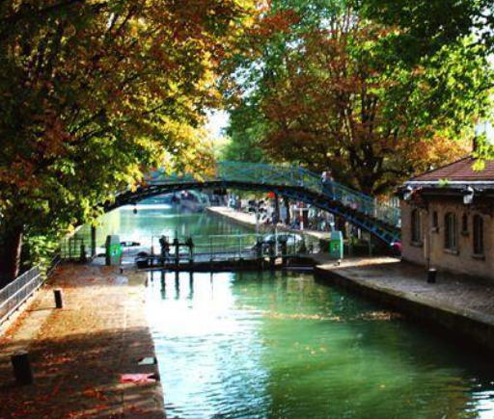
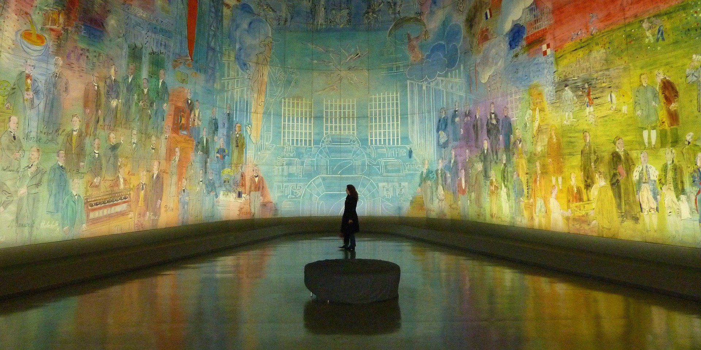


PARIS (FRANCE)
5 best things to experience
Stop everything and watch the Eiffel Towel sparkle
Have a pic-nic by the water
Enjoy live performances and get easily everywhere
Eat the best pastries in the world!
Visit the Palais de Tokyo and MAM
Notes:
Présentation par Mayra – à confirmer
Speech d’intro sur le fait que tu vives à Paris, histoire de la ville, fun act etc
Fun fact : Expliquer le city of « light » (la lumière des intellectuels et non la lumière littérale), plus de chiens à Paris que d’enfants, le syndrome de Paris des touristes, on a dit non à Tom cruise pour être citoyen de Paris ahah

Slide 21

OXFORD (UK)
Our campus
3 reasons to study in Oxford
Banking and Fintech
Tight-knit community
Oxford University
Notes:
HLT

Slide 22
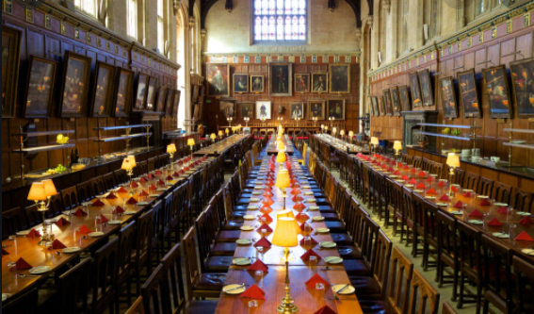
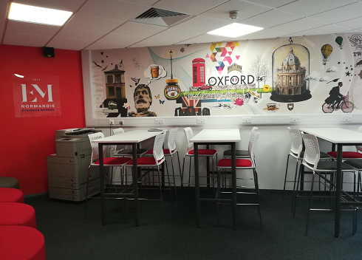

Oxford is for you!
150 000 inhabitants , 40 000 students, 140 nationalities
55 minutes from London
Up to 50 theatres including in colleges
Musicals, Ted Talks, Debate Clubs, Sports, Blenheim Palace 15 miles away
BMW and its famous Mini Plant
…and EM Normandie in the heart of it
Notes:
Présentation par Miriam – diapos de Miriam à rajouter

Slide 23

DUBLIN (IRELAND)
Our campus
3 reasons to study in Dublin
Digital sales
Big Tech companies (GAFAM)
Youngest city in Europe
Notes:
HLT > mettre en avant le fait qu’on ouvre Dublin cette année (M1 & M2, U2 à confirmer par AFR)

Slide 24
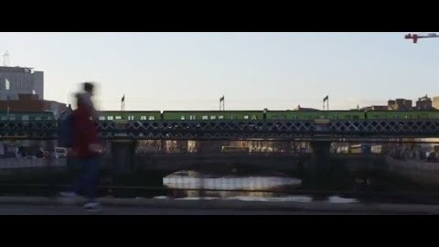
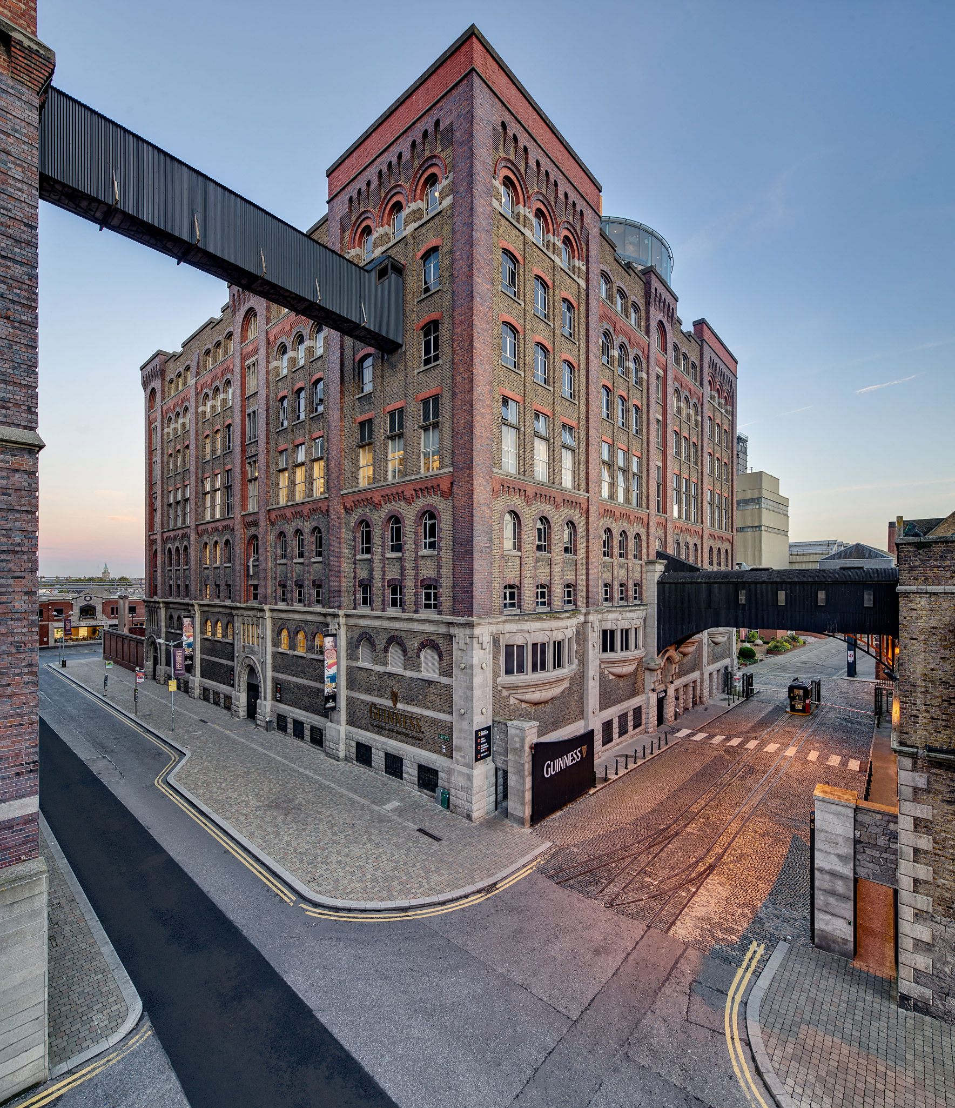

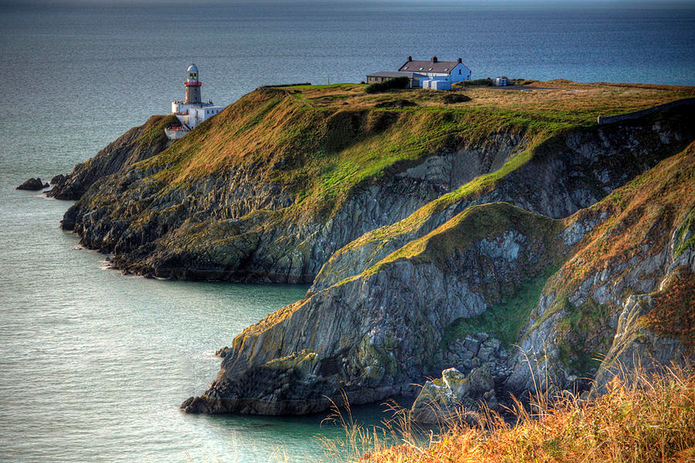

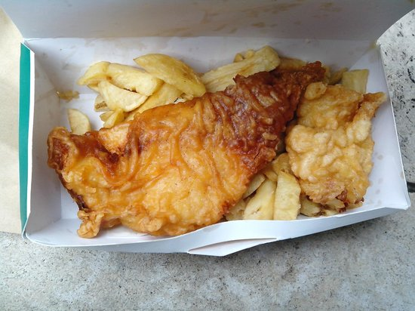
DUBLIN (IRELAND)
5 best things to experience
Visit the Guiness Storehouse Factory
Enjoy St Patrick’s day in Temple Bar
Walk the cliffside in Howth
See the library of Trinity College
Eat Fish’n’chips at Leo Burdocks
Notes:
Founded by the Vikings, called Dubh Linn (means black pool), river Liffey, european hub for big data companies such as FB and Google, 50% of the population under 25y, famous authors (Oscar Wilde, James Joyce, Samuel Beckett) 1 in the 5 « City of Literature » given by the UNESCO, Tv show « Vikings » filmed near Dublin, oldest pub in Ireland called the « Brazen Head », 666 pubs just in Dublin

Slide 25
WELCOMING INTERNATIONAL STUDENTS
https://www.em-normandie.com/en/international-students#exchange-programmes

Slide 26
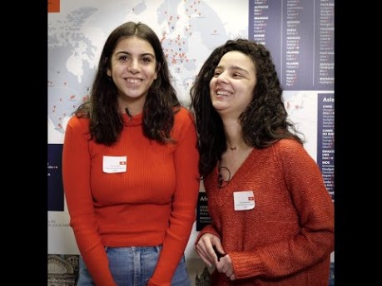
A WIDE INTERNATIONAL PRESENCE
TESTIMONIALS
Notes:
HLT

Slide 27
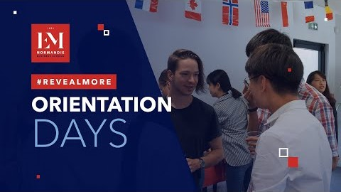
INTERNATIONAL STUDENTS SERVICES
AVAILABLE ON ALL CAMPUSES
Housing
Immigration
Registration
Health coverage
Airport pick up
Orientation days
The HUB
Student societies
Safety
Video:
Kick-off 9/2021

Slide 28
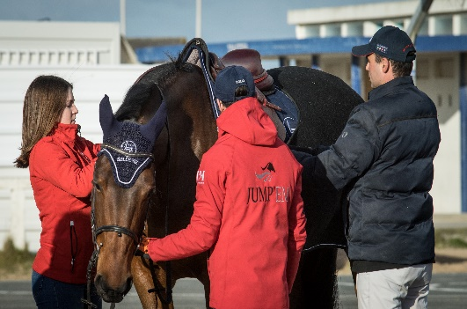
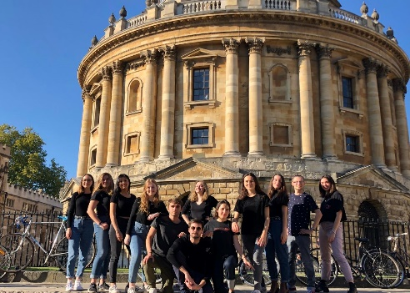
STUDENT CLUBS
GET INVOLVED!
It’s a true breathing space in any French business school!
Student clubs bring extra dynamism to EM Normandie’s campuses by offering exciting events and projects in all domains: culture, sports, humanitarian and professional activities, or just for fun.
Exchange students can enjoy all these activities anytime throughout the semester but in order to participate in projects they will need to be enrolled in a year exchange program.
BDA : Bureau Des Arts (arts & culture club). The BDA aims to promote art and culture in all its forms to students: music, painting, literature, cinema ...
BDS : Bureau Des Sports (sports club). The BDS offers numerous sports activities, competitions and events both within the school and outside.
BDE : Bureau Des Étudiants (students club). The BDE's mission is to integrate all the EMiens and make them enjoy their student life as much as possible, thanks to campus activities and convivial evenings.

Slide 29
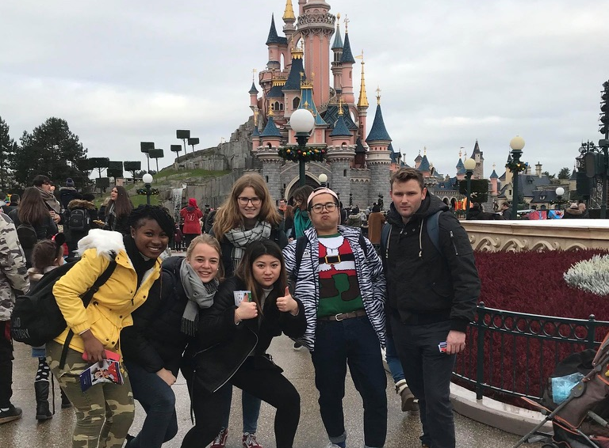
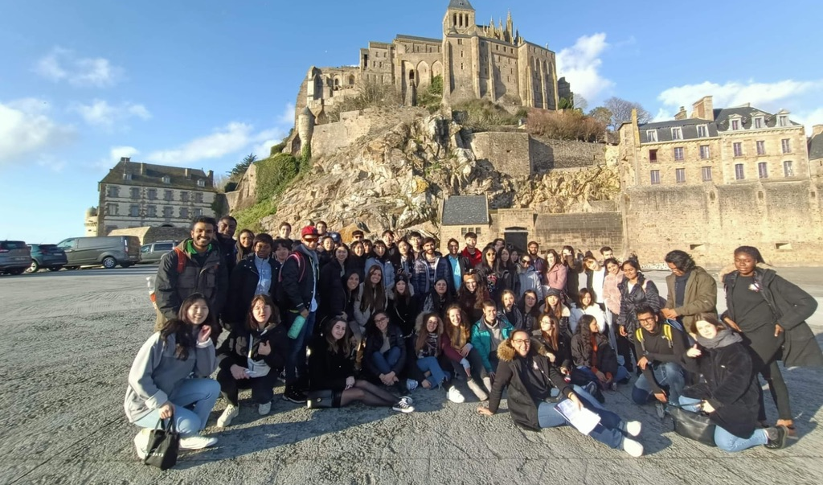
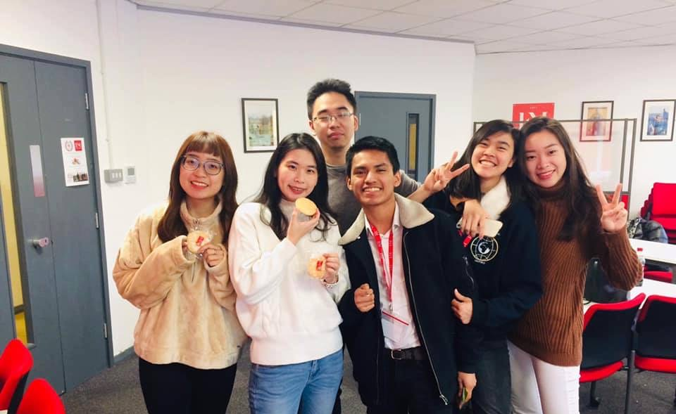
INTERNATIONAL COUNCILS
FOR INTERNATIONAL STUDENTS!
At EM Normandie, you will find students clubs dedicated to welcome international students through fun activities and a buddy program with French students.
Le Havre Instagram: international_council_lehavre
Email: ic.lehavre@em-normandie.fr
Caen Instagram: International_council_caen
Email: ic.caen@em-normandie.fr
Paris Instagram: international_council_paris
Email: coming soon !
Oxford Instagram: international_council_oxford
Email: ic.oxford@em-normandie.fr

Slide 30
OUR INCOMING STUDENTS EXPERIENCE
TESTIMONIALS
“I was pleasantly surprised by how practical the classes at EM Normandie were. I learned a lot by doing real negotiations, analyzing real contracts and work with real businesses. I'm happy I chose for EM Normandie. An experience I won't forget.”
Vincent – KU Leuven, Belgium - Cross-cultural Marketing & Negociation – Caen
“I recommend this program to people who go abroad to gain travelling experience and meet new amazing people.”
Anna – University of Economics in Prague, Czech Republic – European Business Programme – Caen
"I am grateful to have the opportunity to complete part of my career at EM Normandie Oxford, which is a place with excellent academic and human level.”
Basilio – Universidad Siglo 21, Argentina -
M1 Global Track – Oxford
“Studying at the EM Normandie was a nice experience. The facilities of the university and the support of the staff and student organizations were very positive. Especially the International Office."
Jakob – Hochschule Osnabrück, Germany –
European Business Programme – Caen
"EM NORMANDIE places students at the heart of its success! New technologies are used to render classes dynamic and to foster exchanges, which is supported by expert lecturers who are empathetic listeners."
Lucie – Cameroon – M2 Marketing & Stratégie Commerciale – Le Havre
“My stay at EM Normandie was really wonderful, it is an unforgettable experience. I learned a lot and made really such good friends.“
Manav – Chitkara University, India – Cross-cultural Marketing & Negociation – Caen
Video: Student testimonies

Slide 31
ADMISSION PROCESS

Slide 32
ADMISSION PROCESS
4 STEPS
Your home university coordinator or international office nominates you through an online form.
This step is necessary in order to validate your application.
Go to the application link sent by your home university, fill out personal information, choose a programme and upload supporting documents :
- copy of passport
- transcript of records - last diploma (for Graduate)
- language certificate
The International Cooperation department evaluates your application or ask for additional information.
The Letter of Acceptance is sent to you by email from the students’ service (the HUB).
Deadlines
Fall/Academic year: May 15th for nominations, May 30th for applications
Spring: October 15th for nominations, October 31st for applications
For support, candidates can contact incoming@em-normandie.fr

Slide 33
LANGUAGE REQUIREMENTS
ENGLISH PROGRAMMES
Undergraduate
B2, TOEFL IBT 72, IELTS 5.0, TOEIC 750
Graduate
B2, TOEFL IBT 83, IELTS 5.5, TOEIC 790
FRENCH PROGRAMMES
Undergraduate & Graduate
B2, DELF, TCF
We accept language certificates from the home university.
Native students in French or English are waived of this requirement.

Slide 34


We look forward to welcoming you at EM Normandie Business School!
Contact for international students: incoming@em-normandie.fr
https://www.em-normandie.com/en/international-students#exchange-programmes

Slide 35
QUESTIONS / ANSWERS

